Slide 1
Job-Sniffer an AI-Powered Fake Job Post Detector
GBA6410_Group 6
Peiching Tsai, Tingwei Koo, Jacob Rudder, Cedric Wong, Stephen Deng

Slide 2
Agenda
Introduction
Background Research
Data & Preprocessing
Text-Mining Methodology
Implementation
Discussion, Limitation, and Future Research
Conclusion

Slide 3

Introduction
Section Presenter: Jacob

Slide 4
Identifying The Problem
Business Problem Identification
Fake job listings are rising across online platforms
Risks: identity theft, scams, lost time
Manual detection is inefficient and reactive
Goal: Automate scam detection using text analysis
Notes:
With so many people turning to online job boards, scammers have found ways to post fake listings that look legitimate. These scams trick people into giving away personal info or falling for fake job offers. Currently, most platforms rely on users to report scams after the fact, which is slow and unreliable. Our project aims to tackle this by using an AI Agent and text mining to automatically spot fraudulent listings, aiming to catch these listings before the damage is done.

Slide 5
Project Scope & Objectives
What Job-Sniffer Does
Identifies fake vs. real job postings using machine learning and text mining.
Analyzes job descriptions for red flags like vague wording or personal email domains.
Focus on scalability, interpretability, and automation
Protect job seekers from scams, fraud, and data theft
Notes:
The scope of this project revolves around the urgent need to combat fraudulent job postings, which have become more frequent with the rise of online recruitment platforms. Many of these scams are nearly indistinguishable from real listings and pose serious risks (identity theft, financial scams, and time loss).
Job-Sniffer is our AI-driven solution that uses a combination of natural language processing and machine learning to spot linguistic and structural red flags in job descriptions. The system was designed to be scalable, so it can handle large volumes of postings, and interpretable, so its decisions can be understood and validated. Ultimately, our goal is to reduce reliance on manual reporting and provide job seekers with a safer, smarter way to navigate online job markets.

Slide 6

Background Research
Section Presenter: Jacob

Slide 7
Why Do Fake Job Postings Exist?
Motivations include:
Identity theft & phishing
Resume harvesting
Inflated job board activity
Fake company branding
Lack of verification enables fraud.
Economic pressure increases victim risk.
Notes:
Scammers create fake listings for several reasons: to steal personal data, gather resumes to sell, or make a company look like it's hiring when it's not. Some platforms lack safeguards to stop this. And with long job searches—up to 240 days—many applicants are desperate, which makes them easy targets

Slide 8
Key Linguistic Patterns
Studies show fake ads use vague or generic language (e.g., “basic knowledge”, “flexible hours”)
Urgency cues like “immediate hiring” are common in fraudulent listings (Vrinda et al., 2024)
Unrealistic offers such as “easy money” or “free travel” are often red flags (BBB, 2021)
Use of personal email domains (gmail.com, yahoo.com) instead of company emails is a known indicator (Pillai, 2023)
Fake listings typically lack role-specific requirements and professional detail (Sahana & Ashwini, 2024)
Notes:
Our approach is grounded in a growing body of research on job fraud detection. Multiple studies have identified specific linguistic markers that consistently appear in fake postings. For example, vague phrases like “basic knowledge” or “flexible hours” show up frequently in scams, likely to appeal to a wide pool of applicants without scaring anyone off with real qualifications.
Vrinda et al. (2024) specifically noted the presence of urgency cues, phrases like “immediate hiring” or “apply now”, which are often used to pressure applicants. Similarly, the BBB's 2021 report and Pillai’s (2023) work highlight the use of too-good-to-be-true incentives and non-corporate email addresses as common scam tactics.
Sahana and Ashwini (2024) added that real job descriptions tend to include specific skills and expectations, whereas fake ones are often vague, templated, or misleading. These insights from prior studies directly shaped the features our model detects in Job-Sniffer.

Slide 9

Data & Preprocessing
Section Presenter: Stephen

Slide 10
Source Data
Collection of two data sets from Kaggle
Selected due to their relevance and rare inclusion of binary fraud labels
Fake data set composed by Sri Sai Suhas Sanisetty
Includes approximately 10,000 data set
Real data set contributed by Hassan Legends
17,000 real jobs with 866 fake records
27k records with 61% real and 39% fake
Moderate Imbalance
Use oversampling to mitigate the imbalance

Slide 11
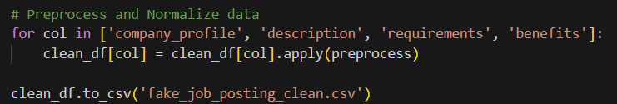
Key Variables
Some variables identified from previous researches
Job title, location, salary range, company profile, description, requirements, benefits, employment type, industry
Our interest for the project
Company Profile
Description
Requirements
Benefits

Slide 12
Preprocessing
Empty Fields
Entries missing the description field were removed from the set
Other missing fields, such as company profile and benefits, were replaced with empty strings to prevent imputation bias
Preprocessing Steps
Regular Expressions (regex): lowercase, remove non-alphanumeric symbols and special characters, collapse white spaces.
NLTK: Tokenization into word-level units, stopword removal using NLTK’s English stopword list, lemmatization to normalize word forms

Slide 13
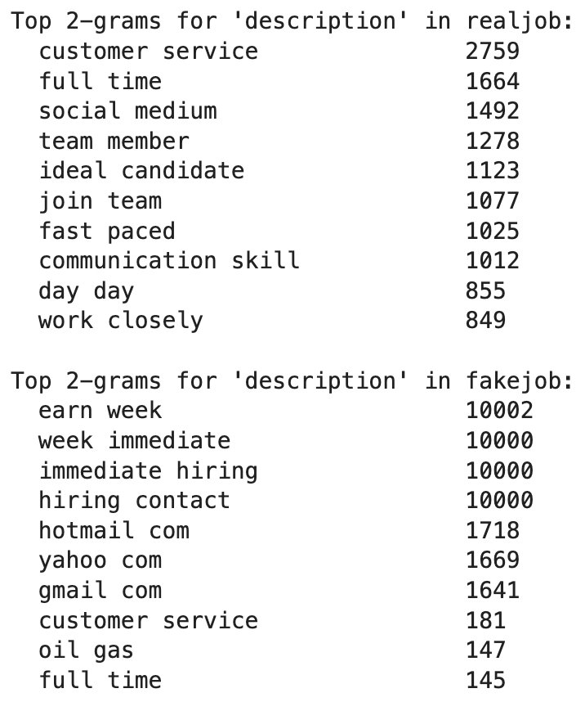
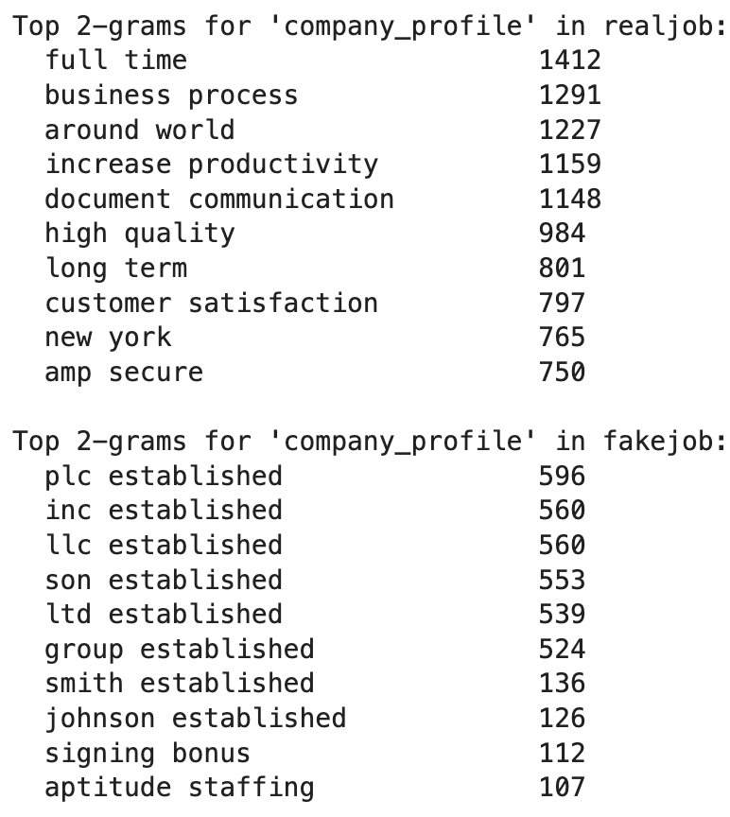
Descriptive Results
Company Profile
Real - Emphasize on core values, operation scope, and modality of the organization
'customer satisfaction' , 'around world', 'long term'
Fake – Reoccurrence of boilerplate historical phrases with no actual finding dates or mission statements
'llc established','signing bonus'
Description
Real – Clarity in roles and importance of teamwork
'communication skill', 'customer service', 'years experience'
Fake – Incongruous wordings with urgency and financial temptations
'immediate hiring', 'earn week',
Connected with unprofessional contact information and unrelated terms

Slide 14
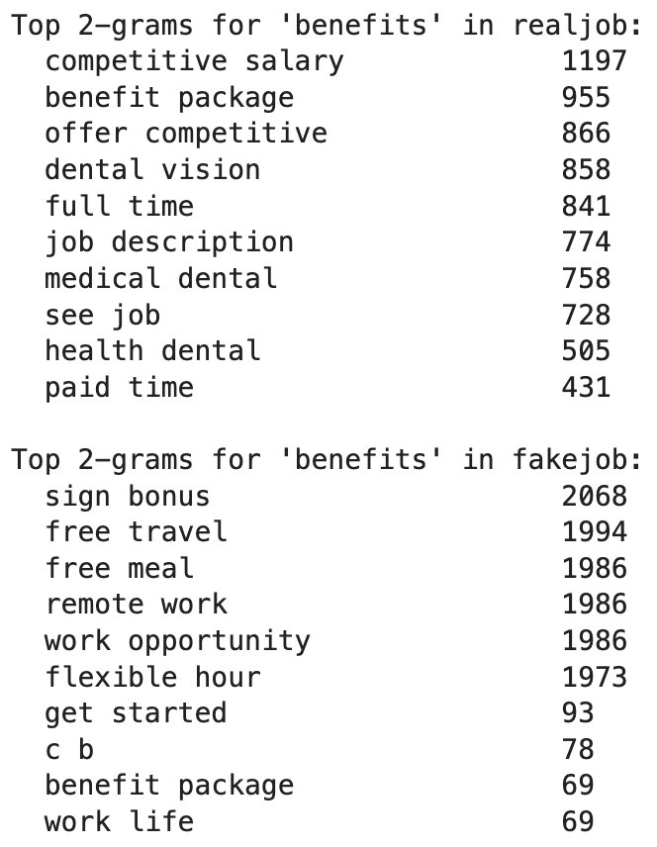
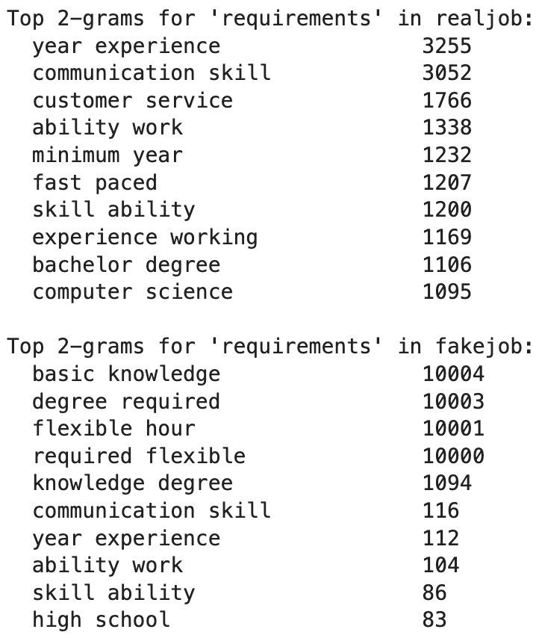
Descriptive Results
Requirements
Real - Requires specific experience and education
'minimum year' , 'bachelor degree', 'computer science'
Fake – Vague and generic qualifiers with appealing phrases
'basic knowledge' , 'flexible hours'
Benefits
Real – Concrete industry standard perks and compensations
'benefit package', 'health dental'
Fake – Vague and attractive incentives
'free meal', 'remote work'

Slide 15

Text-Mining Methodology
Section Presenter: Peiching

Slide 16

Feature Engineering
Prepping ingredients
High-frequency red-flag n-grams (e.g., “LLC established”, “immediate hiring”)
TF-IDF vectors for surface-level term relevance
Sentence-BERT embeddings for contextual semantic modeling
Lexical diversity (via Shannon entropy) and readability scores
Notes:
Red-flag n-grams: short phrases or word pairs that show up a lot in scam job postings. We built a custom dictionary of these suspicious phrases and flag them whenever they appear.
2. TF-IDF vectors (Term Frequency–Inverse Document Frequency): checks how important a word is, based on how often it shows up in one post vs. many others. Words that are common in scams but rare in legit listings will stand out.
3. Sentence-BERT: gives us a deep, contextual understanding of the meaning behind each sentence—not just the words themselves. It captures how words relate to each other in context.
4. Lexical diversity & readability scores: measure how varied and clear the language is. Scam posts often reuse simple, vague words or have poor grammar, while legit posts are more professional and detailed.
*Shannon entropy: it measures how diverse or repetitive the text is. High entropy = The language is rich and varied → more likely to be real; Low entropy = The same words or phrases keep repeating → often scammy or templated
*Readability scores: measure how easy or difficult a piece of text is to read. Based on things like: Average sentence length, Average word length, Syllables per word

Slide 17

System Layers
Cooking
Rule-Based Detection (Scam phrase detector)
Flags known scam phrases and suspicious email domains
Anomaly Detection
Isolation Forest trained on legit job posts, learning what ‘’real” looks like
Detects statistical outliers and unknown scam patterns
Supervised Classifier (Decision-maker)
Random Forest trained on labeled data
Uses concatenated feature set from all layers
Notes:
Rule-Based Detection: It’s fast, explainable, and catches obvious scams before we do any heavy processing.
Anomaly Detection: trained only on legitimate job posts. It learns what ‘normal’ looks like, so if a post deviates too much from that pattern, it gets flagged as an anomaly. This helps us catch new or sneaky scams that don’t follow the usual templates.
Supervised Classifier: “it pulls together all features from all the other layers—rule-based flags, anomaly scores, TF-IDF vectors, Sentence-BERT embeddings—and make the final call to make a prediction.

Slide 18

Implementation
Section Presenter: Tingwei

Slide 19
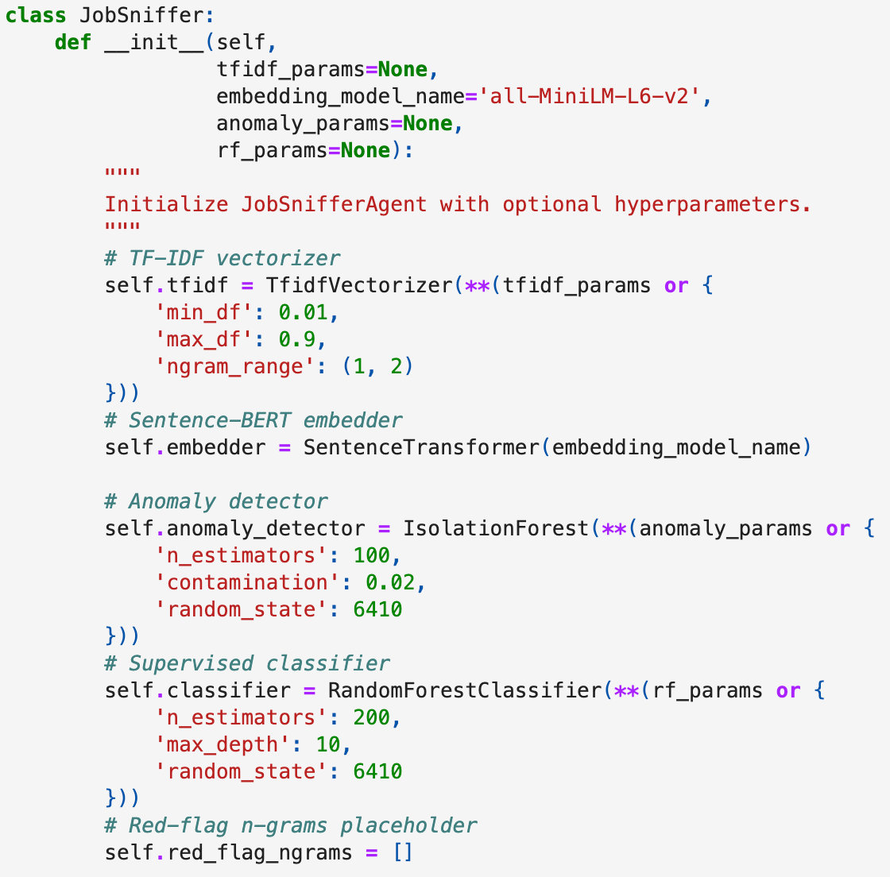
Create JobSniffer Class
__init__ function initializes models and parameters
TF-IDF: Ignores terms in <1% or >90% of documents; uses bigrams as features
Embedder: Used all-MiniLM-L6-V2 to generate semantic text vectors
Anomaly Detection: Isolation Forest with 100 trees; assumes 2% anomalies
Classifier: Random Forest with 200 trees, max depth = 10 to prevent overfitting
Notes:
First, we made a 'JobSniffer' class. This is like the brain of our tool. It uses different parts to understand job postings.
We used something called TF-IDF to find important words, and 'Embedder' to understand the meaning of sentences.
For finding strange job posts, we used 'Anomaly Detection,' and for telling real from fake, we used a 'Classifier.' Each part has its own settings, like how many trees in our 'Random Forest' classifier.

Slide 20
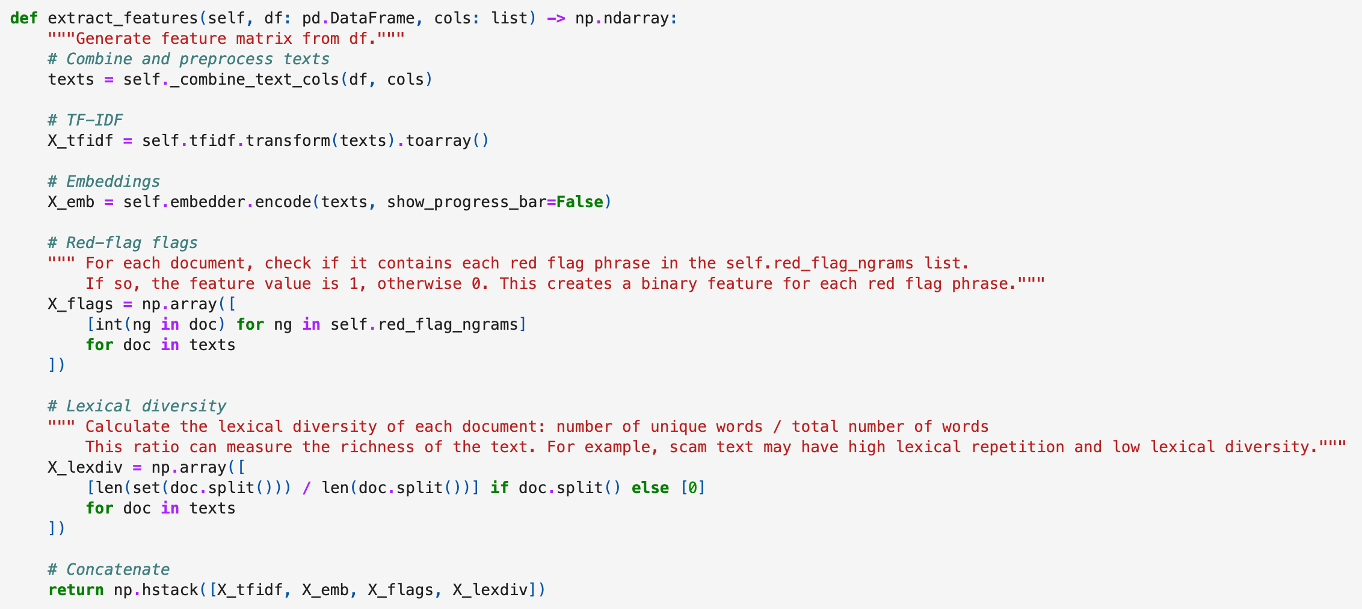
Extract Feature
Converts text into numerical vectors so the machine can process and understand it
Notes:
Next, we need to turn words into numbers so the computer can understand them. This is called 'extracting features.’
We use TF-IDF and Embeddings for this. We also look for 'red flag' words – these are common in scam job posts.
And we check 'lexical diversity' – scam posts often repeat words a lot.

Slide 21
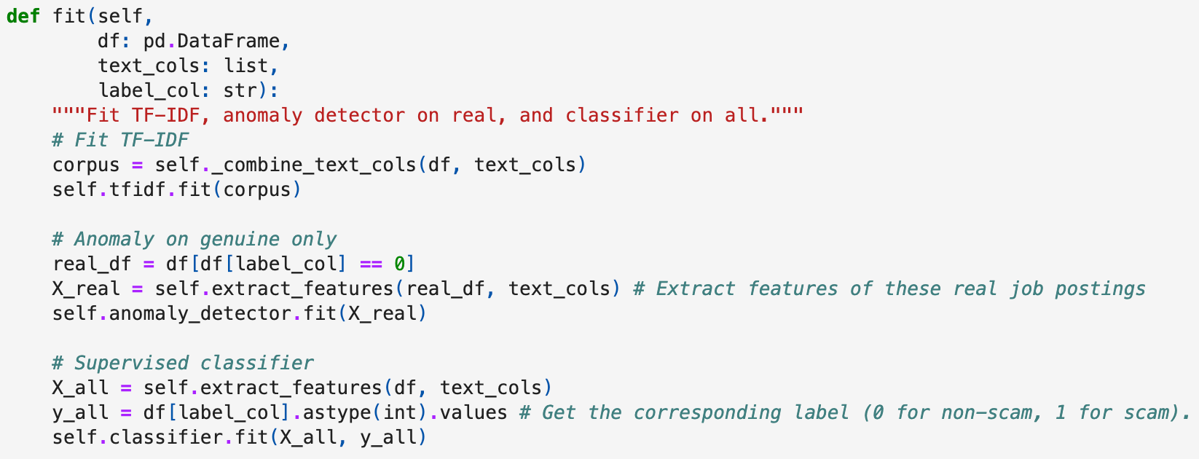
Model Fitting
This method to train each model.
The Anomaly Detector only use real dataset to train the model.
Notes:
After preparing the data, we 'fit' our models.
This means we train them. We train the 'Anomaly Detector' only on real job postings so it learns what 'normal' looks like.
Then, we train the 'Classifier' on both real and fake job postings so it can tell the difference.

Slide 22
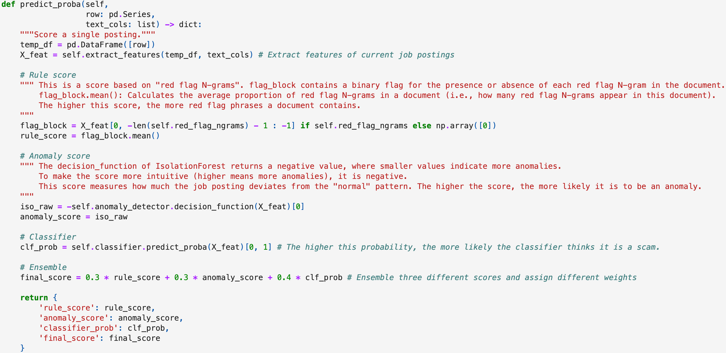
Prediction Score
Scores each job posting based on its likelihood of being fraudulent
Combines three weighted scores to compute a final score:
Rule Score: Based on the average frequency of red flags in the job description. Higher = more suspicious.
Anomaly Score: Derived from a built-in function (e.g., Isolation Forest). Negated for clarity—higher = more anomalous.
Classifier Probability (clf prob): Probability output from the classifier. Higher = higher likelihood of fraud.
Notes:
This method is used to score individual job postings (rows) based on their likelihood of being fraudulent.
We use three types of scores and assign weights to them to calculate a final score:
Rule Score: This score is based on the mean frequency of red flags found in the job posting text. A higher score indicates more red flags and, therefore, a higher likelihood of fraud.
Anomaly Score: We use the built-in function to calculate this score. The original function returns a negative value, but for easier interpretation, we negate the score so that higher values indicate greater anomaly.
Classifier Probability (clf prob): This represents the probability that the job posting is fraudulent. A higher score indicates a higher likelihood of fraud.
When we get a new job posting, we give it a 'prediction score.' This score tells us if it might be a scam. We combine three scores: a 'Rule Score' based on red flag words, an 'Anomaly Score' if it looks unusual, and a 'Classifier Probability' from our classifier. We give different importance to each score to get a final score.

Slide 23
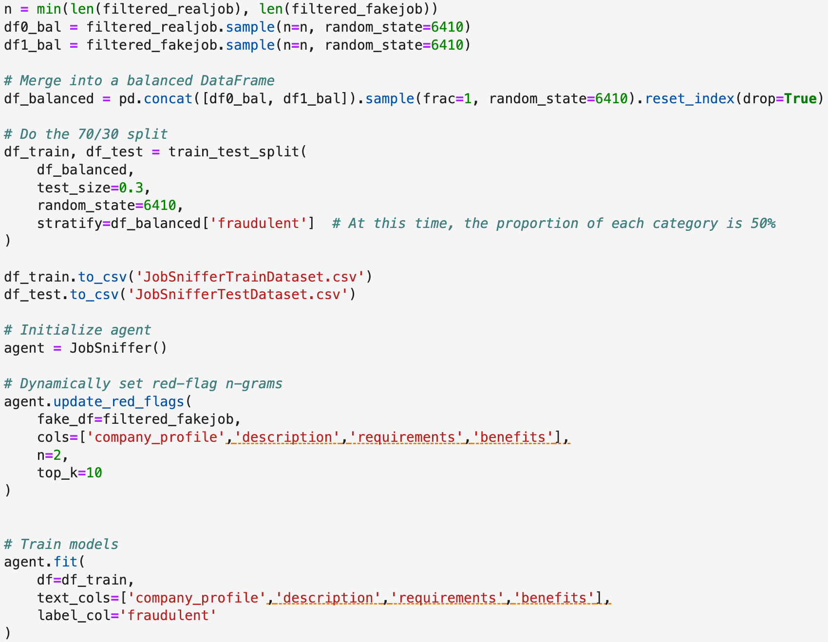
Model Training
Balanced data by downsizing to equalize real vs. fake job postings
Split dataset 70% training / 30% testing
Trained model using the training set and the fit() function
Notes:
To avoid overfitting, we first balanced the dataset by taking the minimum sample size between real and fake job postings and downsizing accordingly, ensuring both classes had the same number of samples.
After that, we split the dataset into a 70/30 ratio for training and testing purposes.
Finally, we used the training dataset and applied the fit function to train our model.
To train our model, we first made sure we had an equal number of real and fake job postings. Then, we split our data: 70% for training and 30% for testing. We used the training data to teach our JobSniffer how to spot scams.

Slide 24
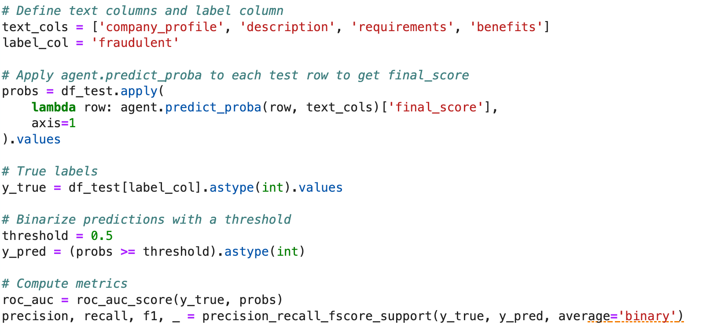
Model Validating
Used test dataset to generate prediction probabilities
Classified postings as fraudulent if probability > 0.5, otherwise legitimate
Evaluated performance using sklearn.metrics to calculate AUC-ROC, F1 score, recall, and precision
Notes:
Finally, we checked how good our model is. We used the test data to get prediction scores.
If a score was over 0.5, we said it was fake.
Then, we used special tools to measure how well our model performed, looking at things like AUC-ROC, F1 score, recall, and precision.

Slide 25

Discussion, Limitations & Future Research
Section Presenter: Cedric

Slide 26
Result-1
 | Predicted Real (0) | Predicted Fake (1)
Actual Real (0) | 3260 | 0
Actual Fake (1) | 239 | 3020
ROC-AUC: 0.996
Precision: 1.000
Recall: 0.927
F1-score: 0.962
Notes:
This confusion matrix shows that the model correctly predicted all real jobs (3260) as real and successfully predicted the vast majority (3020) of scam jobs, but incorrectly predicted 239 real scam jobs as real.

Slide 27
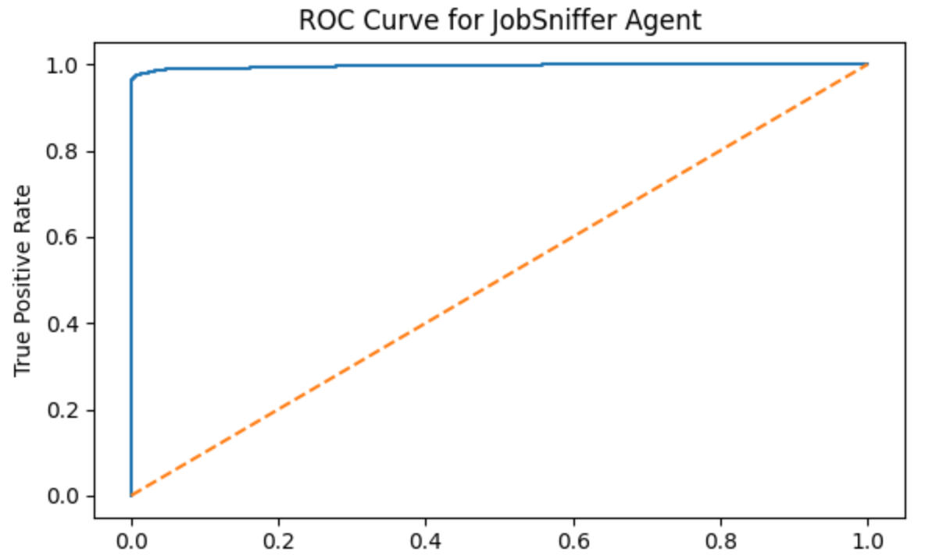
Result-2
Notes:
This ROC curve is very close to the upper left corner, showing that JobSniffer Agent has a very high and near-perfect classification ability in distinguishing between fraudulent and non-fraudulent jobs.

Slide 28
Interpretation of Results
Obtained 92% or greater under several standard performance metrics
ROC-AUC
Recall
Precision
F1-Score
1.0 precision indicates agent is perfect at identifying positives
Overall high performance means agent is ready for implementation

Slide 29
Ethical AI Considerations
Merging two datasets may have caused bias in favor of the larger one
Protected user privacy by removing potentially sensitive columns prior to text mining
Location
Salary range
Benefits

Slide 30
Project Limitations and Future Research
Needed two datasets to have enough of both fraudulent and genuine postings
Future efforts ideally would use data from a single source instead
Project has tens of thousands of data points, but at large scale would be expected to work with millions of entries
Needs further efficiency testing at the big data level before implementation

Slide 31

Conclusion
Section Presenter: Cedric

Slide 32
Conclusion
Fraudulent posts have several text-based tells that distinguish them
Excessive urgency
Unrealistic incentives
Personal email domains
Other indicators
Minimal qualifications
Generic company profiles
Agent can detect fraudulent posts with high accuracy
Will be useful for improving consumer trust in job board sites and AI usage

Slide 33
Thank You

